Slide 1
iFour Consultancy
CSS (Cascading Style Sheets)
Notes:
Software Outsourcing Company India - http://www.ifourtechnolab.com/

Slide 2

Introduction To CSS
A markup language is a set of markup tags
A markup language is a set of markup tags
What Is CSS?
Is a style sheet language used for describing the look and formatting of a document written in a markup language.
2
Notes:
Software Outsourcing Company India - http://www.ifourtechnolab.com/

Slide 3
CSS Usage
A markup language is a set of markup tags
A markup language is a set of markup tags
There are 3 ways to add CSS style to the HTML document
Inline style - giving a style attribute to HTML elements
Internal style - using the <style> element in the <head> section
External style - creating an external CSS file
<h2 style="color:red;">Some heading</h2>
Inline Style
<style>
h2{color:red;}
</style> <h2>Some heading</h2>
Internal Style
<head>
<link rel="stylesheet" type="text/css" href="style.css">
</head>
External Style
3
Notes:
Software Outsourcing Company India - http://www.ifourtechnolab.com/

Slide 4
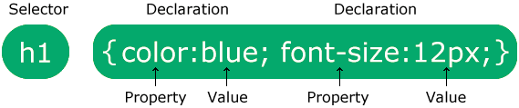
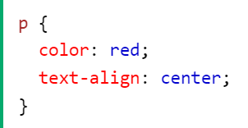
CSS Syntax
A markup language is a set of markup tags
A markup language is a set of markup tags
A CSS rule consists of a selector and a declaration block.
p is a selector in CSS (it points to the HTML element you want to style: <p>).
color is a property, and red is the property value
text-align is a property, and center is the property value
4
Notes:
Software Outsourcing Company India - http://www.ifourtechnolab.com/

Slide 5
CSS id and class
A markup language is a set of markup tags
A markup language is a set of markup tags
An ID selector is a unique identifier of the HTML element to which a particular style must be applied.
A class selector is used when the same style must be applied to multiple HTML elements on the same web page.
<style>
.class-name{color:red;}
</style> <h2 class=“class-name”>Some heading</h2>
Class Selector
<style>
#id-name{color:red;}
</style> <h2 id=“id-name”>Some heading</h2>
Id Selector
5
Notes:
Software Outsourcing Company India - http://www.ifourtechnolab.com/

Slide 6
CSS Selectors
A markup language is a set of markup tags
A markup language is a set of markup tags
A CSS selector selects the HTML element(s) you want to style.
We can divide CSS selectors into five categories:
Simple selectors (select elements based on name, id, class)
Combinator selectors (select elements based on a specific relationship between them)
Pseudo-class selectors (select elements based on a certain state)
Pseudo-elements selectors (select and style a part of an element)
Attribute selectors (select elements based on an attribute or attribute value)
p {color: red;}
Simple Selector
div > p {color:red;}
Combination Selector
a: link{color: red;}
Pseudo-class Selector
Attributes Selector
P::first-line {color: red;}
Pseudo-elements Selector
input[type="text"] {width: 120px}
6
Notes:
Software Outsourcing Company India - http://www.ifourtechnolab.com/

Slide 7
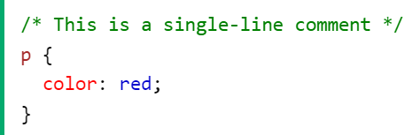
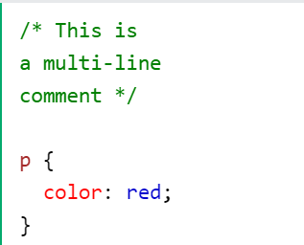
CSS Comments
A markup language is a set of markup tags
A markup language is a set of markup tags
CSS comments are not displayed in the browser, but they can help document your source code.
Single line
Multiple line
7
Notes:
Software Outsourcing Company India - http://www.ifourtechnolab.com/

Slide 8
CSS Text
A markup language is a set of markup tags
A markup language is a set of markup tags
Here we look at properties that can assist in styling your text
Text color
Text alignment
Text decoration
Text transform
Text shadow
Text indentation
Letter spacing
Line height
Word spacing
Syntax
color: color
text-align: left | right | center | justify
text-decoration: none | underline |overline | line-through | blink
text-transform: none | capitalize | uppercase | lowercase
text-shadow: h-shadow v-shadow blur-radius color | none
text-indent: length | percentage
letter-spacing: normal | length
line-height: normal | number | length
word-spacing: normal | length
8
Notes:
Software Outsourcing Company India - http://www.ifourtechnolab.com/

Slide 9
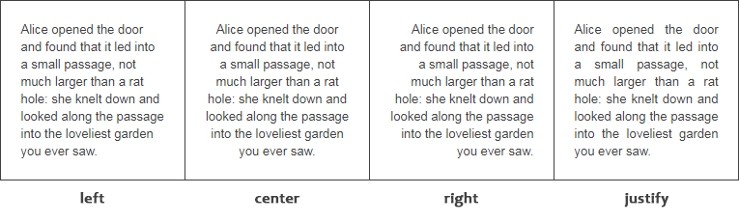
CSS Text – Practice
A markup language is a set of markup tags
A markup language is a set of markup tags
Let try to practice to code bellow
9
Notes:
Software Outsourcing Company India - http://www.ifourtechnolab.com/

Slide 10


CSS Font
A markup language is a set of markup tags
A markup language is a set of markup tags
The CSS font properties are used for defining the size, font family, boldness and the style of the text.
Font Family
Font Style
Font Size
Font Weight
Font Variant
Syntax
font-family: family-name
font-style: normal | italic | oblique
font-size: medium | xx-small | x-small | small | large | x-large | xx-large | smaller | larger | length
font-weight: normal | bold | bolder | lighter | number
font-variant: normal | small-caps
10
Notes:
Software Outsourcing Company India - http://www.ifourtechnolab.com/

Slide 11
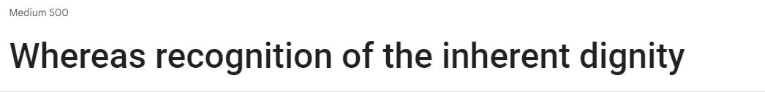
CSS Font - Practice
A markup language is a set of markup tags
A markup language is a set of markup tags
Use google font to make font <https://fonts.google.com/specimen/Roboto>
11
Notes:
Software Outsourcing Company India - http://www.ifourtechnolab.com/

Slide 12
CSS Link
A markup language is a set of markup tags
A markup language is a set of markup tags
To make style link
The four links states are:
a:link - a normal, unvisited link
a:visited - a link the user has visited
a:hover - a link when the user mouses over it
a:active - a link the moment it is clicked
a:link {color: red;}
a:visited {color: green;}
a:hover {color: hotpink;}
a:active {color: blue;}
12
Notes:
Software Outsourcing Company India - http://www.ifourtechnolab.com/

Slide 13
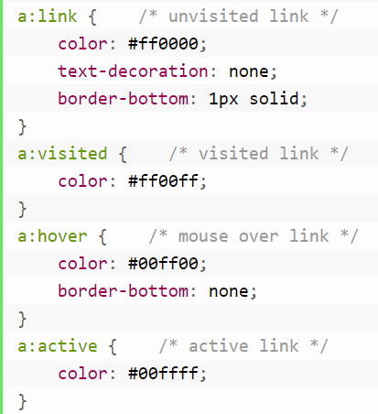
CSS Link - Practice
A markup language is a set of markup tags
A markup language is a set of markup tags
CSS
HTML
<a href=“#" target="_top">Visit Tutorial Republic</a>
13
Notes:
Software Outsourcing Company India - http://www.ifourtechnolab.com/

Slide 14
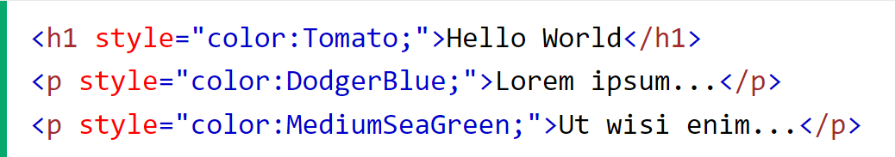
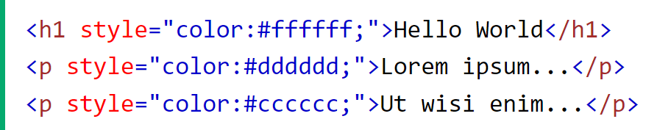
CSS Colors
A markup language is a set of markup tags
A markup language is a set of markup tags
Colors are specified using predefined color names, or HEX
14
Notes:
Software Outsourcing Company India - http://www.ifourtechnolab.com/

Slide 15
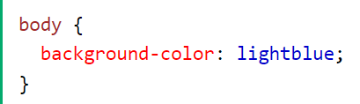
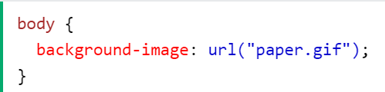
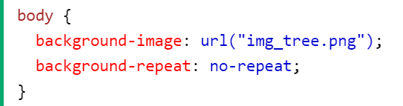
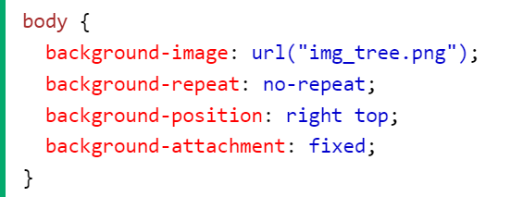
CSS Backgrounds
A markup language is a set of markup tags
A markup language is a set of markup tags
The CSS background properties are used to add background effects for elements.
CSS background properties:
background-color
background-image
background-repeat
background-attachment
background-position
background (shorthand property)
15
Notes:
Software Outsourcing Company India - http://www.ifourtechnolab.com/

Slide 16
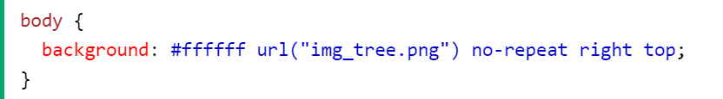
CSS Backgrounds - Shorthand property
A markup language is a set of markup tags
A markup language is a set of markup tags
When using the shorthand property. The order of the property values is:
background-color
background-image
background-repeat
background-attachment
background-position
16
Notes:
Software Outsourcing Company India - http://www.ifourtechnolab.com/

Slide 17
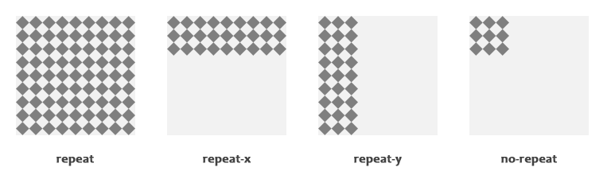
CSS Backgrounds - Practice
A markup language is a set of markup tags
A markup language is a set of markup tags
Let's take a look at the following illustration
17
Notes:
Software Outsourcing Company India - http://www.ifourtechnolab.com/

Slide 18
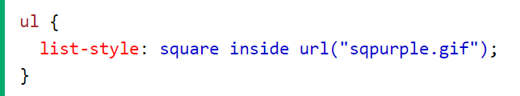
CSS List
A markup language is a set of markup tags
A markup language is a set of markup tags
properties are used to make style of list.
Properties:
list-style-type - property specifies the type of list item marker – (square, circle...)
List-style-image – specify an image of list item maker
List-style-position – specify a position of the item maker – (inside, outside)
Shorthand property
18
Notes:
Software Outsourcing Company India - http://www.ifourtechnolab.com/

Slide 19
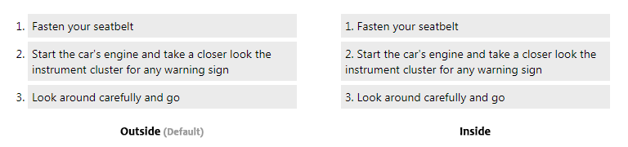
CSS List - Practice
A markup language is a set of markup tags
A markup language is a set of markup tags
Let's take a look at the following illustration.
19
Notes:
Software Outsourcing Company India - http://www.ifourtechnolab.com/

Slide 20
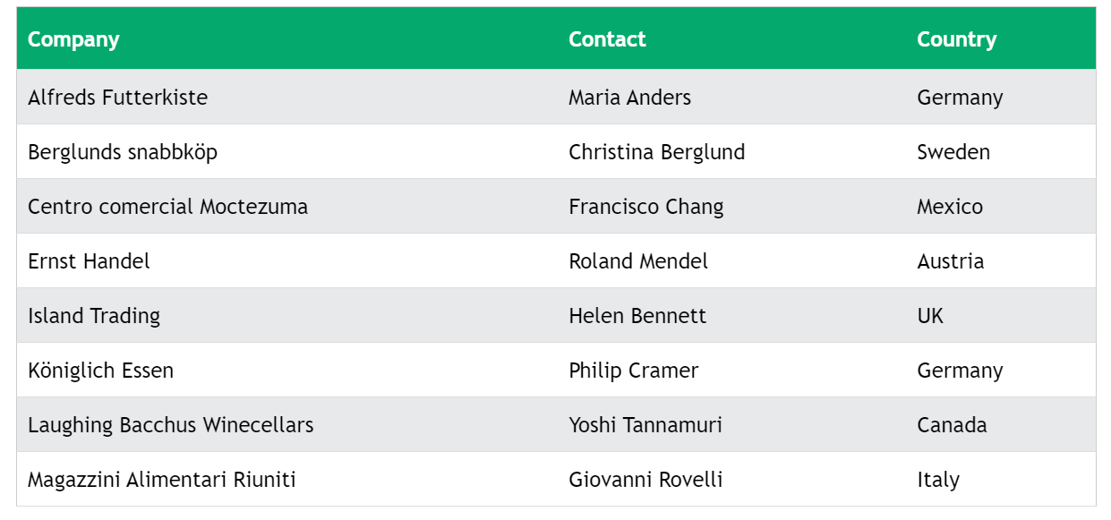
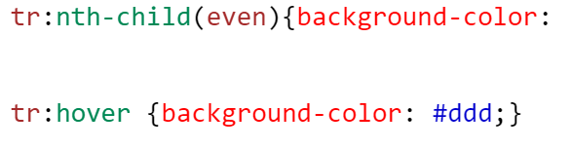
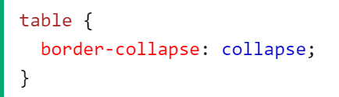
CSS Table
A markup language is a set of markup tags
A markup language is a set of markup tags
Make HTML Table look good.
20
Notes:
Software Outsourcing Company India - http://www.ifourtechnolab.com/

Slide 21
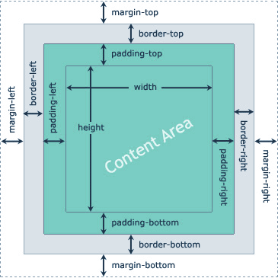
CSS Box Model
A markup language is a set of markup tags
A markup language is a set of markup tags
The CSS box model divides each HTML element into four areas: content, padding, border, and margin. These areas determine how the element is displayed on a web page.
21
Notes:
Software Outsourcing Company India - http://www.ifourtechnolab.com/

Slide 22
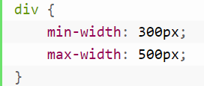
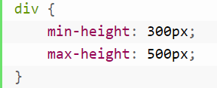
CSS Dimension
A markup language is a set of markup tags
A markup language is a set of markup tags
CSS has several dimension properties, such as width, height, max-width, min-width, max-height, and min-height that allows you to control the width and height of an element.
22
Notes:
Software Outsourcing Company India - http://www.ifourtechnolab.com/

Slide 23
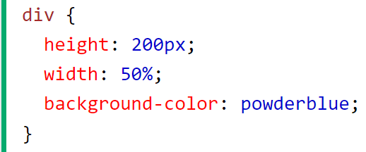
CSS Height, Width and Max-width
A markup language is a set of markup tags
A markup language is a set of markup tags
properties are used to generate space around an element's content, inside of any defined borders.
Properties for specifying the margin:
width
height
max-width
Margins can have following values:
auto – the browser calculates the margin
length – Specify a margin in px, em
% - Specify a margin in %
23
Notes:
Software Outsourcing Company India - http://www.ifourtechnolab.com/

Slide 24
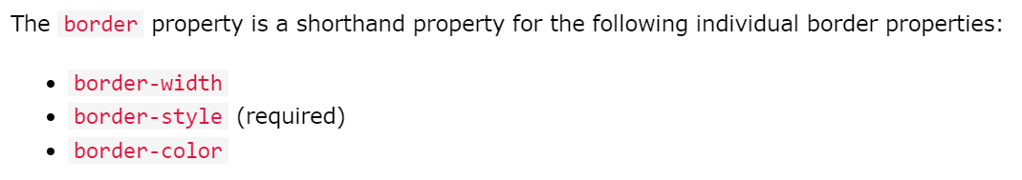
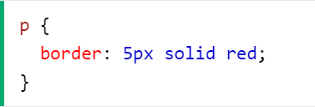
CSS Borders
A markup language is a set of markup tags
A markup language is a set of markup tags
The CSS border properties allow you to specify the style, width, and color of an element's border.
24
Notes:
Software Outsourcing Company India - http://www.ifourtechnolab.com/

Slide 25
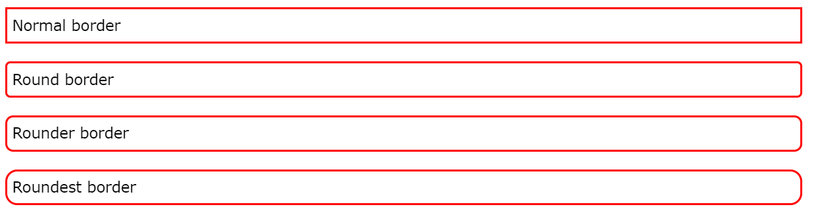
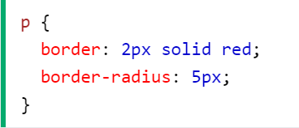
CSS Rounded Borders
A markup language is a set of markup tags
A markup language is a set of markup tags
The border-radius property is used to add rounded borders to an element
25
Notes:
Software Outsourcing Company India - http://www.ifourtechnolab.com/

Slide 26
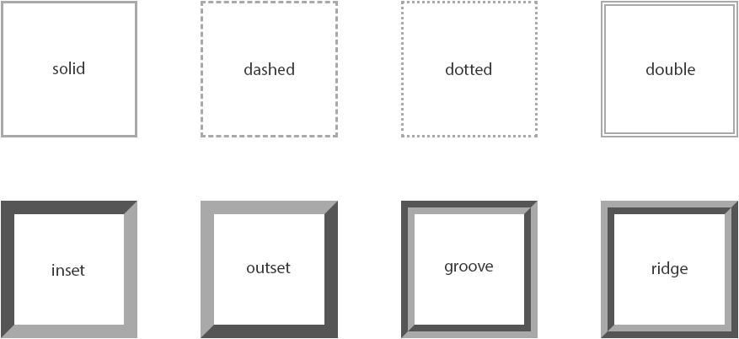
CSS Borders - Practice
A markup language is a set of markup tags
A markup language is a set of markup tags
26
Notes:
Software Outsourcing Company India - http://www.ifourtechnolab.com/

Slide 27
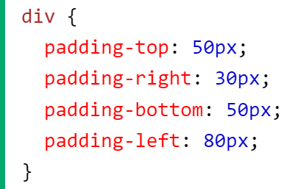
CSS Padding
A markup language is a set of markup tags
A markup language is a set of markup tags
properties are used to generate space around an element's content, inside of any defined borders.
Properties for specifying the margin:
padding-top
padding-right
padding-bottom
padding-left
Margins can have following values:
auto – the browser calculates the margin
length – Specify a margin in px, pt, cm
% - Specify a margin in %
27
Notes:
Software Outsourcing Company India - http://www.ifourtechnolab.com/

Slide 28
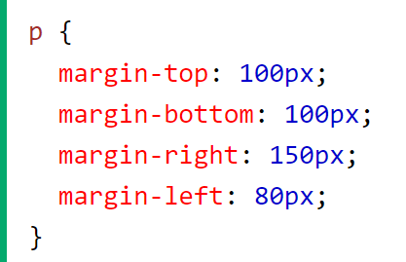
CSS Margins
A markup language is a set of markup tags
A markup language is a set of markup tags
Margins are used to create space around elements, outside of any defined borders.
Properties for specifying the margin:
margin-top
margin-right
margin-bottom
margin-left
Margins can have following values:
auto – the browser calculates the margin
length – Specify a margin in px, pt, cm
% - Specify a margin in %
28
Notes:
Software Outsourcing Company India - http://www.ifourtechnolab.com/

Slide 29
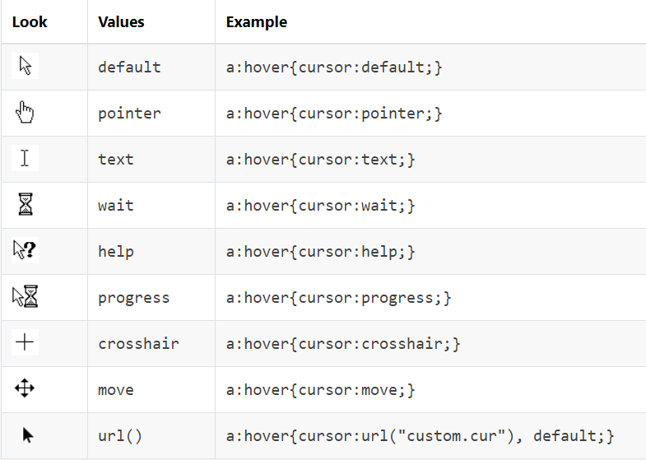
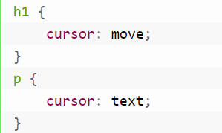
CSS Cursors
A markup language is a set of markup tags
A markup language is a set of markup tags
CSS cursor property used to define cursor type (i.e. mouse pointer) when the mouse moves over a certain area or, over a link on the webpage.
29
Notes:
Software Outsourcing Company India - http://www.ifourtechnolab.com/

Slide 30
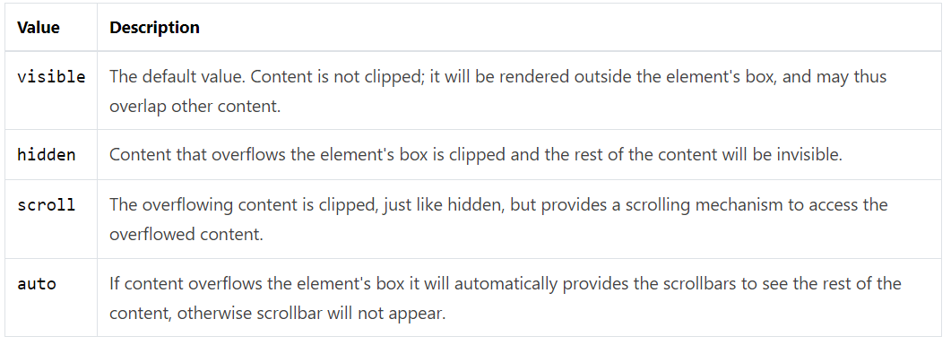
CSS Overflow
A markup language is a set of markup tags
A markup language is a set of markup tags
The overflow property specifies the behavior that occurs when an element's content overflows (doesn't fit) the element's box. Ex: overflow: scroll
30
Notes:
Software Outsourcing Company India - http://www.ifourtechnolab.com/

Slide 31
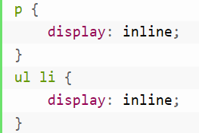
CSS Display
A markup language is a set of markup tags
A markup language is a set of markup tags
The CSS specification defines the default display value for all the elements.
Display Block - forces an element to behave like block-level element.
Display Inline - causes an element to behave as though it were an inline-level element.
Display Inline-Block - causes an element to generate a block box that will be flowed with surrounding content.
Display None - causes an element to generate no boxes at all.
31
Notes:
Software Outsourcing Company India - http://www.ifourtechnolab.com/

Slide 32
CSS Display – Practice
A markup language is a set of markup tags
A markup language is a set of markup tags
Coding to make this menu bellow
32
Notes:
Software Outsourcing Company India - http://www.ifourtechnolab.com/

Slide 33
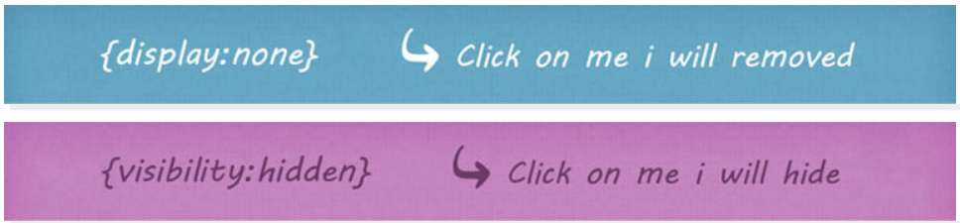
CSS Visibility
A markup language is a set of markup tags
A markup language is a set of markup tags
The visibility property determines whether an element is visible or hidden.
visibility: hidden; hides the element, but it still takes up space in the layout.
display: none; turns off the display and removes the element completely from the document.
33
Notes:
Software Outsourcing Company India - http://www.ifourtechnolab.com/

Slide 34
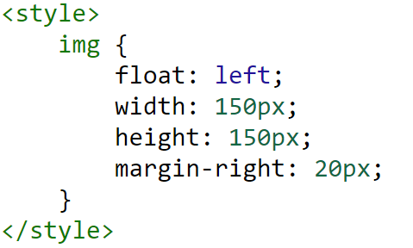
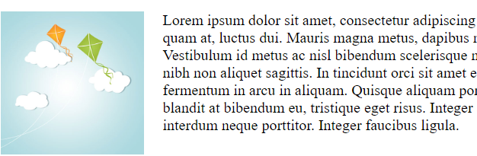
CSS Float
A markup language is a set of markup tags
A markup language is a set of markup tags
The CSS float property specifies whether a box should float or not. Float can be left, right and none.
34
Notes:
Software Outsourcing Company India - http://www.ifourtechnolab.com/

Slide 35
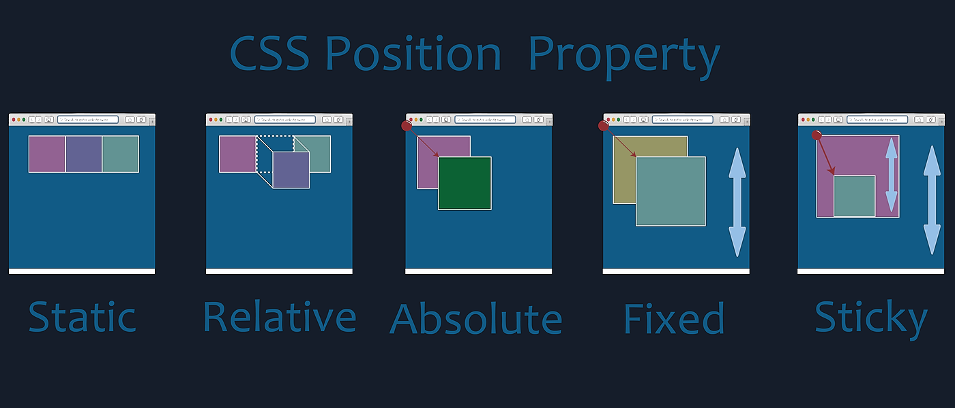
CSS Position
A markup language is a set of markup tags
A markup language is a set of markup tags
The position property defines how an element will be positioned on a page.
Relative Positioning – is positioned relative to its normal position.
Absolute Positioning – is positioned relative to the first parent element.
Fixed Positioning – a fixed positioned element.
35
Notes:
Software Outsourcing Company India - http://www.ifourtechnolab.com/

Slide 36

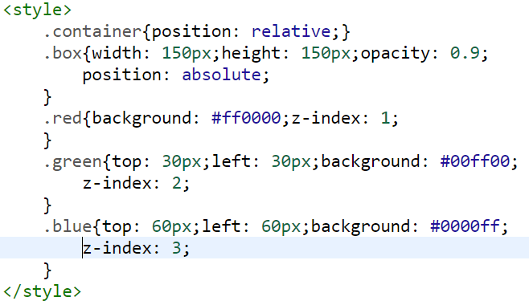
CSS Layers
A markup language is a set of markup tags
A markup language is a set of markup tags
The z-index property specifies the stack order of an element.
It only works on positioned elements (position: absolute, position: relative, position: fixed, or position: sticky) and flex items
z-index: auto|number
<div class="container">
<div class="box red"></div>
<div class="box green"></div>
<div class="box blue"></div>
</div>
36
Notes:
Software Outsourcing Company India - http://www.ifourtechnolab.com/

Slide 37
CSS Alignment
A markup language is a set of markup tags
A markup language is a set of markup tags
CSS has several properties that can be used to align elements on web pages.
Text Alignment – can be aligned the text to right, left and center. Ex: text-align: left
Center Alignment – using the margin Property. Ex: margin: 0 auto
Aligning Elements – using the position Property
Left and Right Alignment – Using the float Property
37
Notes:
Software Outsourcing Company India - http://www.ifourtechnolab.com/

Slide 38
CSS Pseudo-classes
A markup language is a set of markup tags
A markup language is a set of markup tags
Allow you to style the dynamic states of an element such as hover, active and focus state, as well as elements that are existing in the document tree.
Syntax
The :first-child Pseudo-class
The :last-child Pseudo-class
The :nth-child Pseudo-class
Pseudo-classes and CSS Classes - can be combined with CSS classes
selector:pseudo-class { property: value; }
38
Notes:
Software Outsourcing Company India - http://www.ifourtechnolab.com/

Slide 39
CSS Pseudo-elements
A markup language is a set of markup tags
A markup language is a set of markup tags
Allow you to style the elements or parts of the elements without adding any IDs or classes to them with bellow syntax:
The ::first-line - applies special style to the first line of a text.
The ::first-letter - is used to add a special style to the first letter of the first line of a text.
The ::before and ::after - can be used to insert generated content either before or after an element's content.
Pseudo- elements and CSS Classes
selector::pseudo-element { property: value; }
39
Notes:
Software Outsourcing Company India - http://www.ifourtechnolab.com/

Slide 40
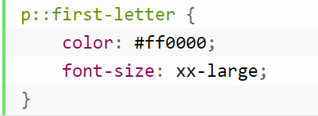


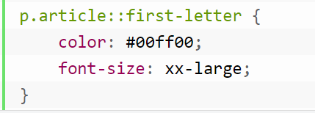

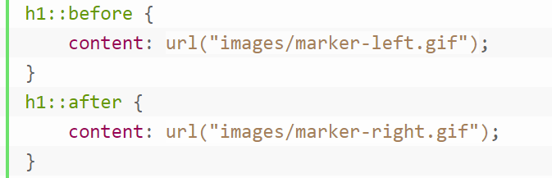
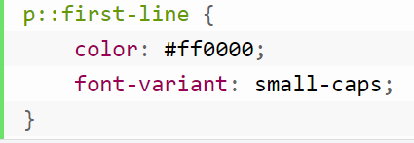
CSS Pseudo-elements - Example
A markup language is a set of markup tags
A markup language is a set of markup tags
40
Notes:
Software Outsourcing Company India - http://www.ifourtechnolab.com/

Slide 41
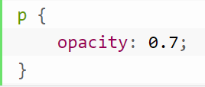
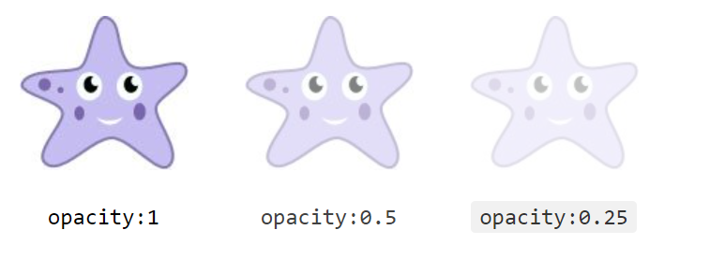
CSS Opacity
A markup language is a set of markup tags
A markup language is a set of markup tags
The opacity CSS property specifies the transparency of an element.
Image: https://www.tutorialrepublic.com/lib/images/star-fish.jpg
41
Notes:
Software Outsourcing Company India - http://www.ifourtechnolab.com/

Slide 42
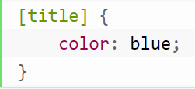
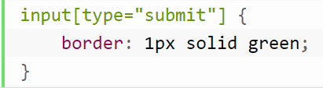
CSS Attribute Selectors
A markup language is a set of markup tags
A markup language is a set of markup tags
Provides an easy and powerful way to apply the styles on HTML elements based on the presence of a particular attribute or attribute value.
CSS [attribute] Selector
CSS [attribute="value"] Selector
42
Notes:
Software Outsourcing Company India - http://www.ifourtechnolab.com/

Slide 43
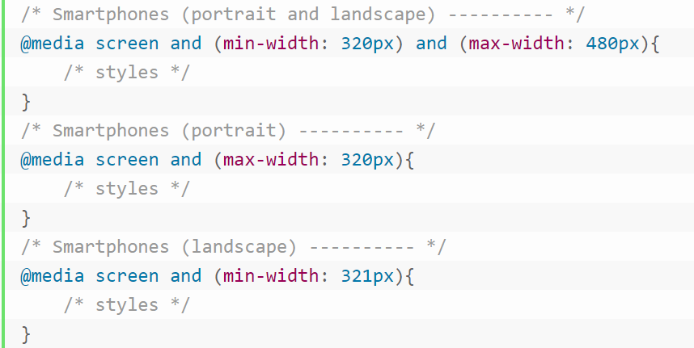
CSS Media Queries
A markup language is a set of markup tags
A markup language is a set of markup tags
enable you to format your documents to be presented correctly on different size of output devices.
43
Notes:
Software Outsourcing Company India - http://www.ifourtechnolab.com/

Slide 44
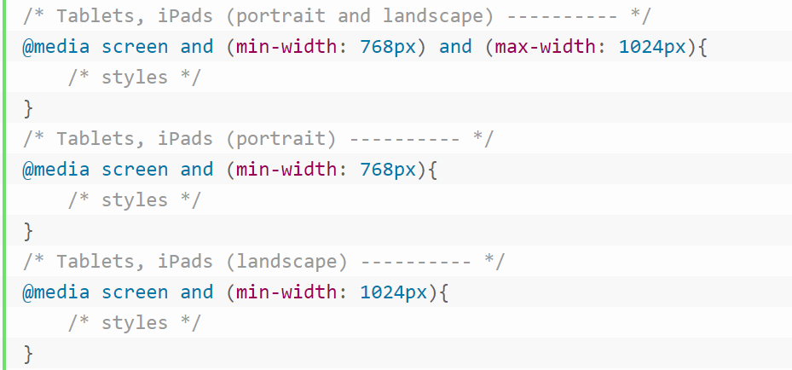

CSS Media Queries
A markup language is a set of markup tags
A markup language is a set of markup tags
44
Notes:
Software Outsourcing Company India - http://www.ifourtechnolab.com/

Slide 45
CSS Framework
A markup language is a set of markup tags
A markup language is a set of markup tags
A CSS framework is a library of pre-written CSS code that can be used to quickly and easily create attractive and functional web pages.
The best css framework for 2023:
Bootstrap - is a popular CSS framework that includes a grid system, pre-styled components, and tools for creating responsive websites.
Tailwind CSS - is a newer CSS framework that is gaining popularity. It is a minimalist framework that focuses on providing developers with the tools they need to create custom styles.
45
Notes:
Software Outsourcing Company India - http://www.ifourtechnolab.com/

Slide 46
Thank You…
https://www.tutorialrepublic.com/css-tutorial/css-text.php
Notes:
Software Outsourcing Company India - http://www.ifourtechnolab.com/

